Slide 1

HZAU-China 2019

Slide 2
Description

Slide 3
Inspiration
Video and Audio signals can be both recorded and reproduced.
But how about odor signals?
We aim to utilize E. coli to record some of the most pleasant smell and reproduce them when we require.

Slide 4
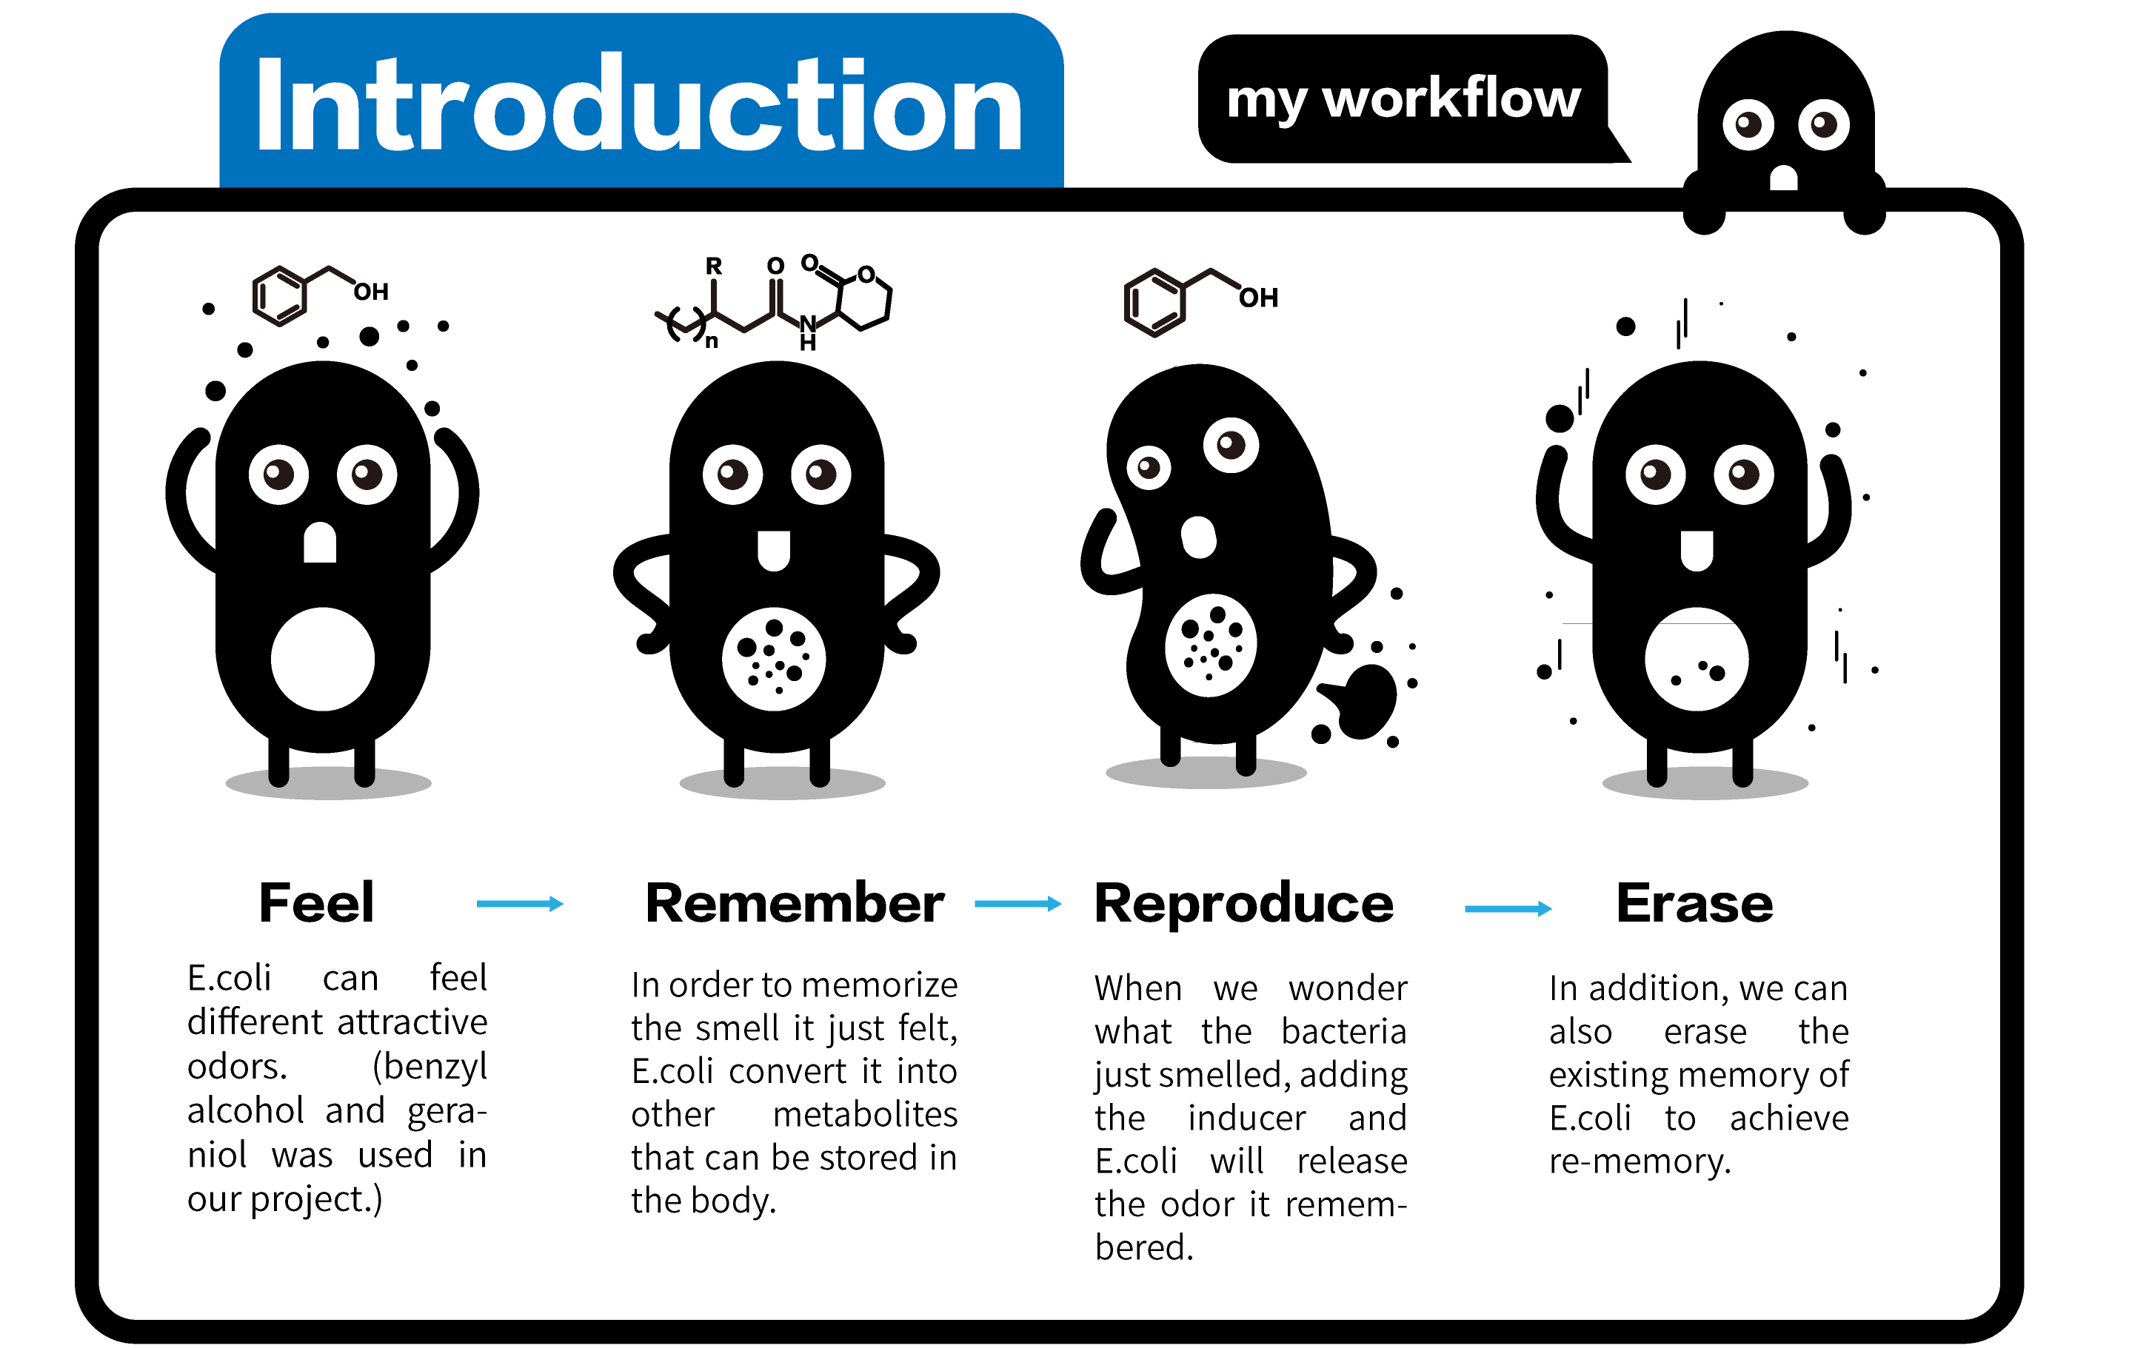

Slide 5
Design

Slide 6
aTc
Benzyl alcohol
Geraniol
Erase module
Perception Module
Quorum-sensing quenching
Benzyl alcohol perception
Geraniol perception
IPTG
IPTG
Memory module
Memory module
Quorum-sensing
Quorum-sensing
taRNA1
accumulation
taRNA2 accumulation
Release module
Release module
Benzyl alcohol synthesis
Geraniol synthesis

Slide 7
Benzyl alcohol perception module
Benzyl alcohol
J23110
areR
areO
P_{are}
luxI
The origin of are operon ：Acinetobacter sp. Strain ADP1
A positive-inducible operon which can percept Benzyl alcohol
Induce initial LuxI
New part
Jones, R. M. & Williams, P. A. (2001)
Huo, Y.-X. et al. (2009).

Slide 8
Benzyl alcohol memory module
luxR
luxI
taRNA1
J23102
lux box
P_{Rlux}
lux box
P_{Rlux}
LuxI
Catalyze
LuxR
taRNA1
3OC6-HSL
Catalyze
Initial LuxI
1. Isaacs, F. J. et al (2004)
2. Greenberg, E. P. & Egland, K. A. (1999)
3. Pai, A., Tanouchi, Y. & You, L. (2012)
3OC6-HSL- LuxR

Slide 9
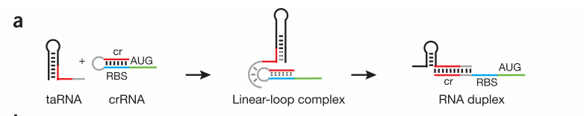
Benzyl alcohol release module
On the mRNA, the crRNA will form a hair-pin structure with RBS, thus preventing the translation of the synthetases.
taRNA specifically trans-activates the translation by removing the hair-pin structure.
Design better taRNA-crRNA pair for parts improvement.
IPTG
taRNA1
crRNA1
Synthetase
J23100
LacI
P_{lac}
Isaacs, F. J. et al. (2004)

Slide 10
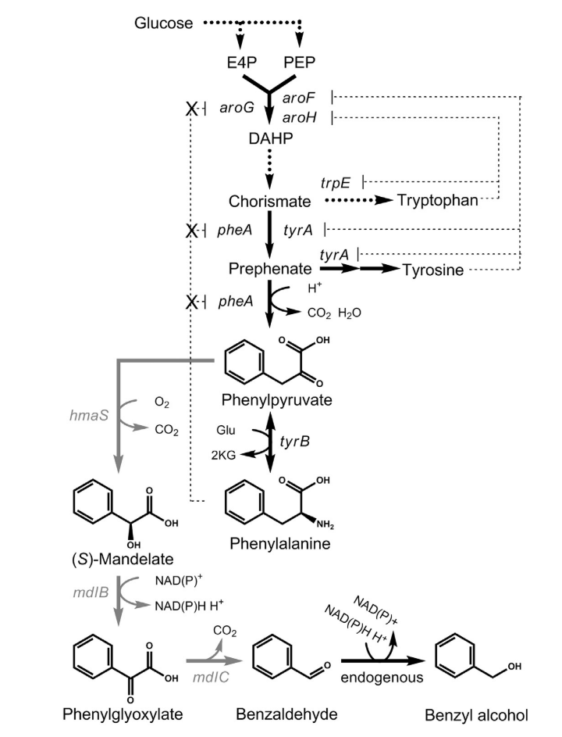
Benzyl alcohol synthesis
Starting from glucose to synthesize Benzyl alcohol
Shikimic acid pathway
Folk at Phenylpyruvate
hmaS（annotated as vcm17 ），from Amycolatopsis orientalis HCCB10007
mdlB，from Pseudomonas putida ATCC 12633
mdlC，from Pseudomonas putida ATCC 12633
1. Pugh, S., McKenna, R., Halloum, I. & Nielsen, D. R. (2015)

Slide 11
Geraniol perception
Putative Promoter
lasI
atuR
Putative
Promoter
香叶醇
The origin of atu operon：Pseudomonas aeruginosa PAO1
A negative-inducible operon which can percept geraniol
Induce initial LasI
New part
Förster-Fromme, K. et al. (2006).
Förster-Fromme, K. & Jendrossek, D. (2010).

Slide 12
Geraniol memory module
lasR
lasI
taRNA2
J23102
P_{las}
P_{las}
LasI
Catalyze
LasR
taRNA2
3OC12-HSL
Catalyze
Initial LasI
Isaacs, F. J. et al (2004).
Grant, P. K. et al (2016).
3OC12-HSL-LasR

Slide 13
Geraniol release module
On the mRNA, the crRNA will form a hair-pin structure with RBS, thus preventing the translation of the synthetases.
taRNA specifically trans-activates the translation by removing the hair-pin structure.
Design better taRNA-crRNA pair for parts improvement.
IPTG
taRNA2
crRNA2
Synthetase
J23100
LacI
P_{lac}
Isaacs, F. J. et al. (2004).

Slide 14
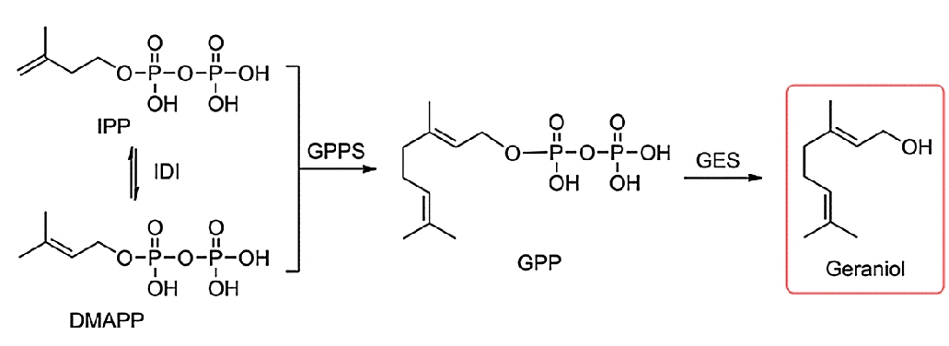
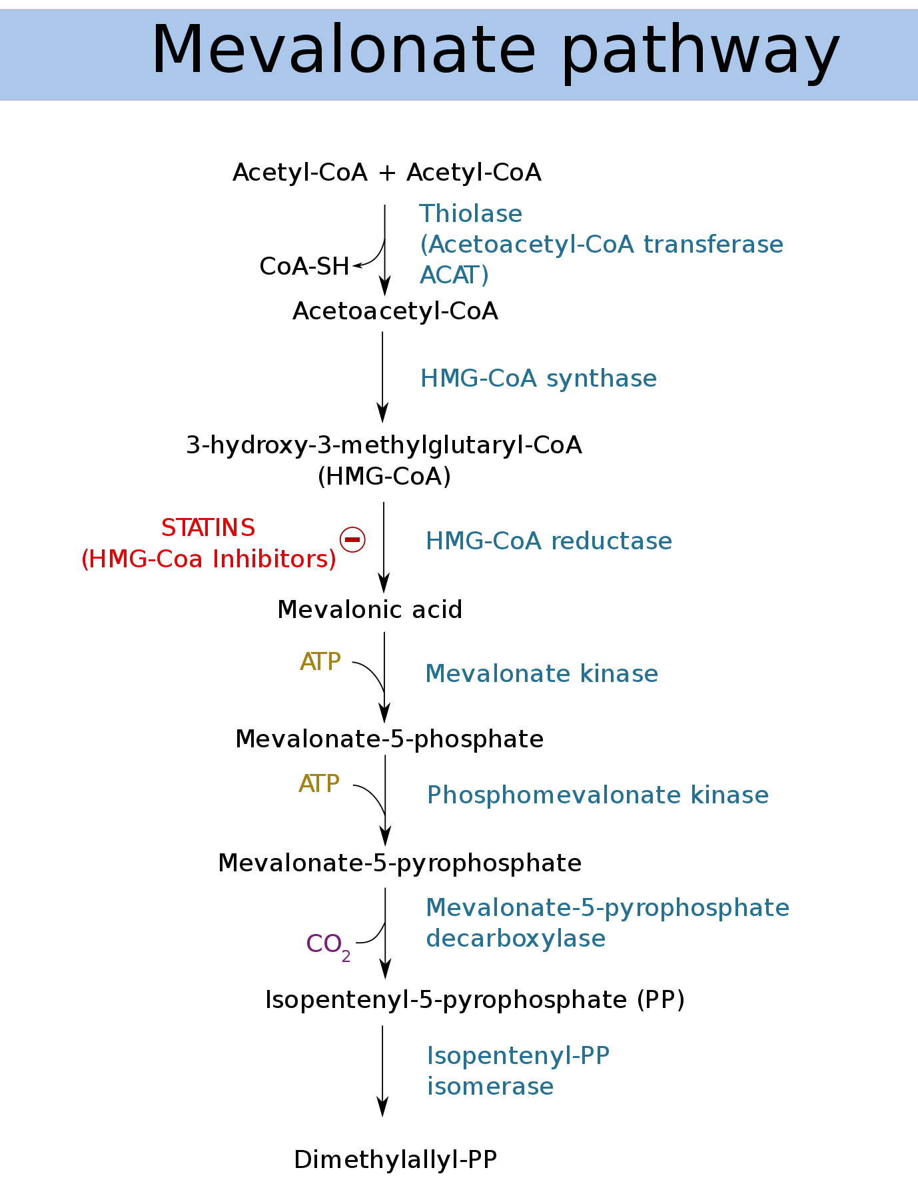
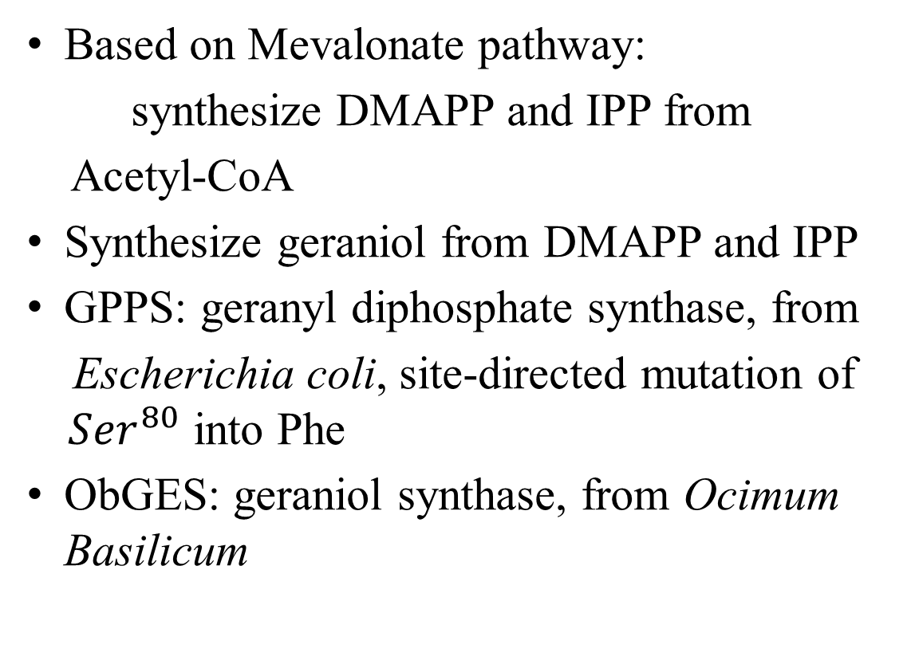
Geraniol synthesis
Based on Mevalonate pathway:
synthesize DMAPP and IPP from
Acetyl-CoA
Synthesize geraniol from DMAPP and IPP
GPPS: geranyl diphosphate synthase, from
Escherichia coli, site-directed mutation of ${ Ser}^{80}$ into Phe
ObGES: geraniol synthase, from Ocimum Basilicum
Fei Chen, Wei Li, et al. (2016)

Slide 15
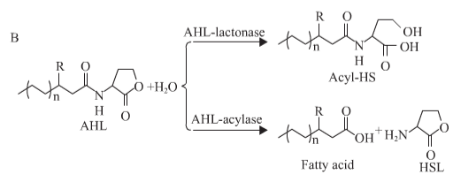
Erase module
AiiO，Acyl-homoserine lactone acylase, can hydrolyze the amide bond of AHL.
Origin：Ochrobactrum sp. A44
Terminate the quorum sensing,
thus erasing the memory
ATc
tetR
P_{tetA}
AiiO
P_{tetR}
Li, Y. et al (2019)

Slide 16
Wet Lab

Slide 17
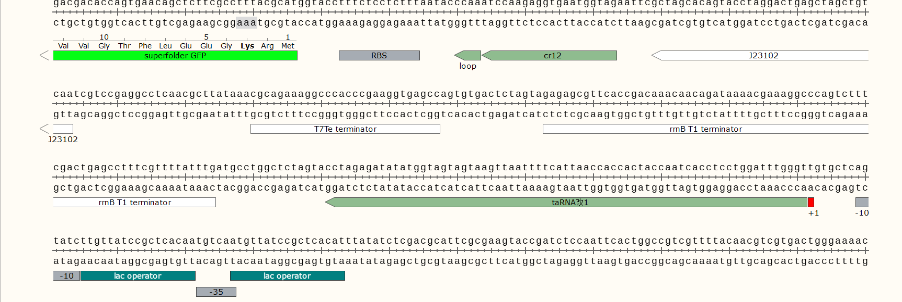
taRNA(ta12 mk0)-crRNA(cr12) interact

Slide 18
 | Rep1 | Rep2 | Rep3 | Rep4 | avg | stderr
-IPTG | 293.9297 | 312.6984 | 155.1247 | 179.6657 | 235.35 | 34.42
+IPTG | 1870.968 | 1827.055 | 1508.772 | 1492.47 | 1674.82 | 87.49
The difference between the two treatments has reached extremely significant level. The fold-change is about 8.

Slide 19
Model

Slide 20
Our model
Odor perception model
Odor memory model
Odor release model
Memory erase model
Metabolic model
Hardware

Slide 21
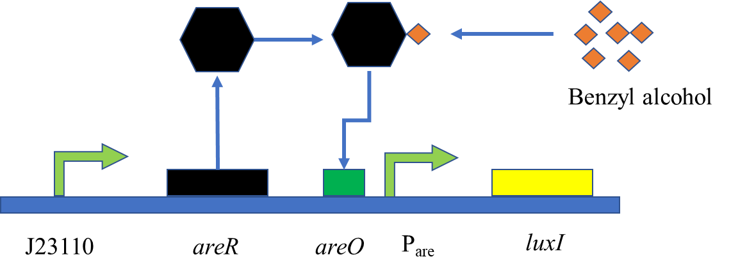
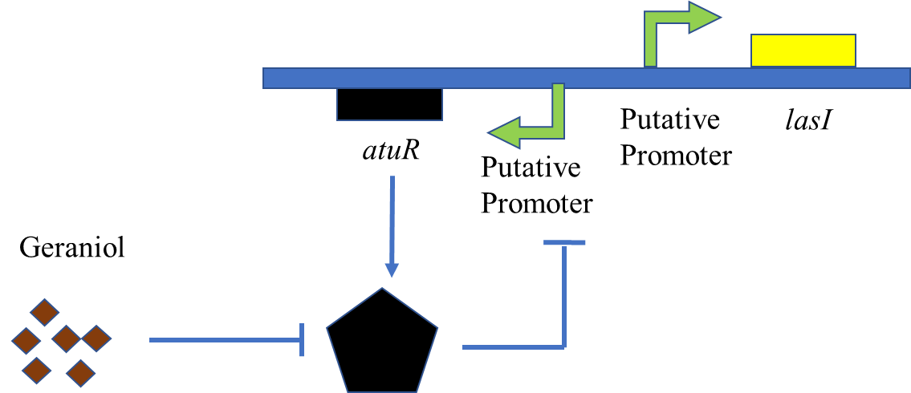
Odor perception model：
A certain amount of AHL accumulates and triggers the memory system
Benzyl alcohol/Geraniol
LuxI/LasI
Catalyze
AHL
AHL

Slide 22
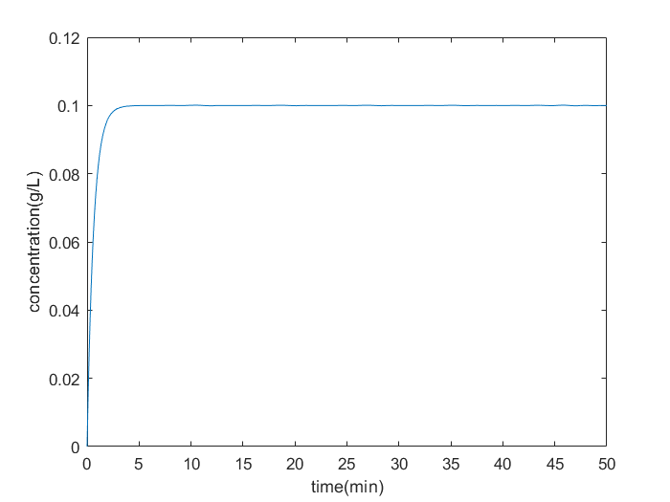
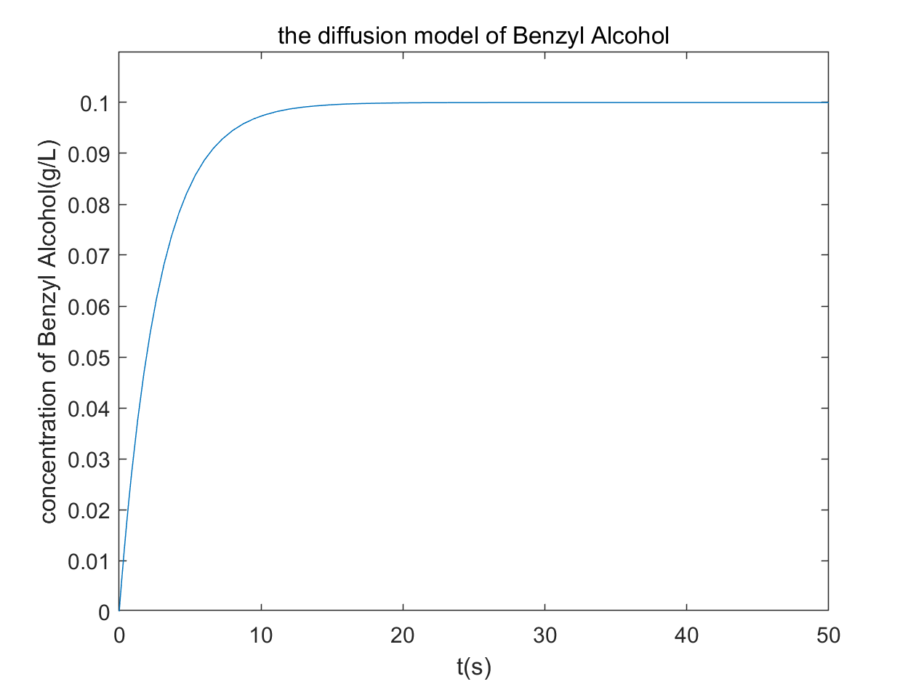
The diffusion model of Geraniol
The diffusion model of Benzyl Alcohol

Slide 23
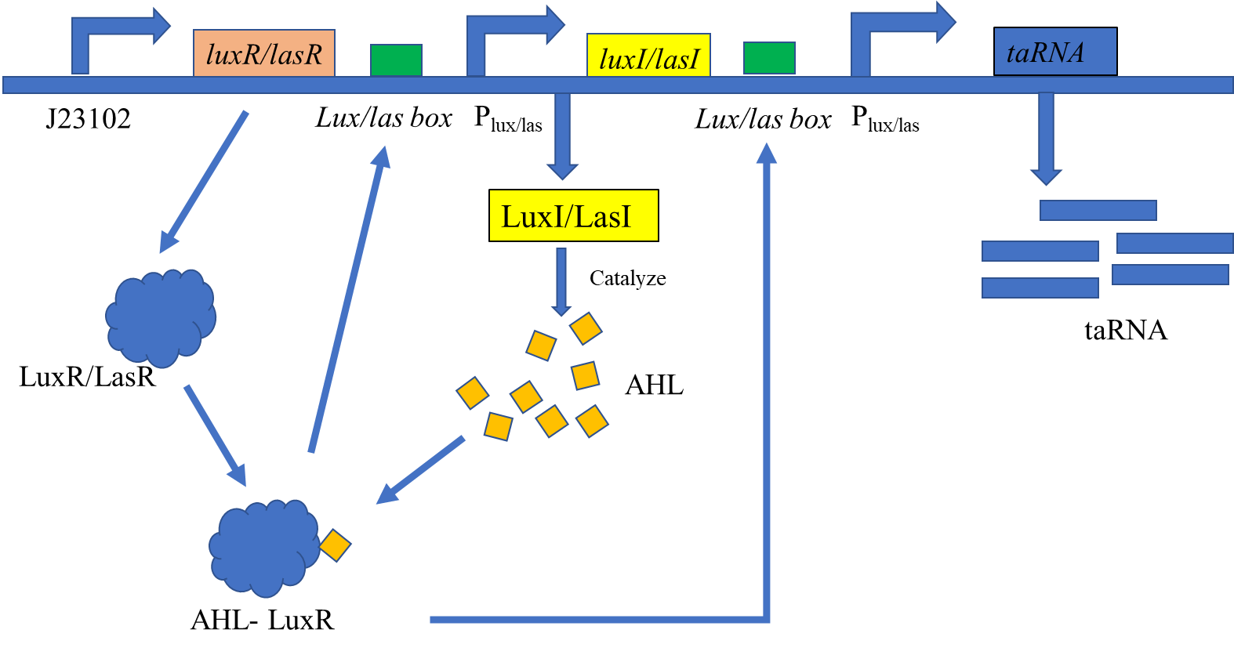
Odor memory model：
What substances do we need to quantify ？
previous step
AHL
LuxR/LasR
Complex(AHL-LuxR)
taRNA

Slide 24
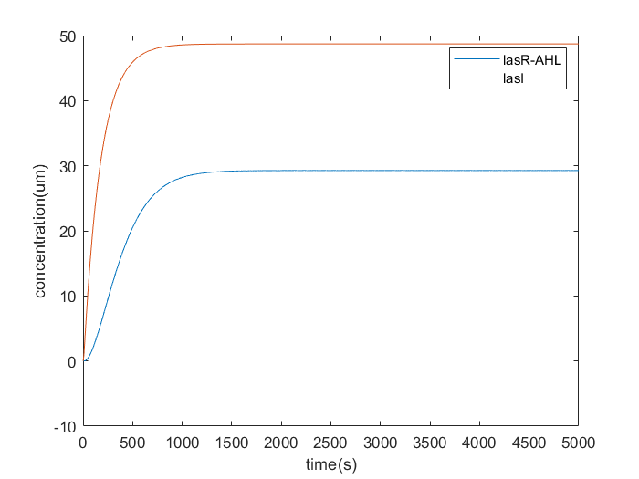
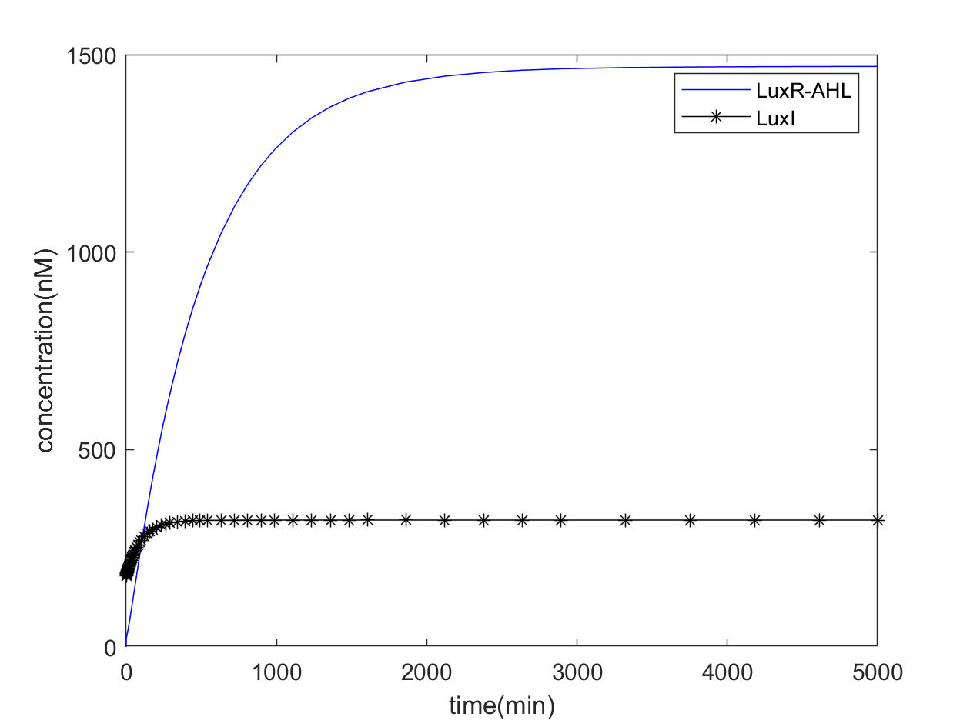
The concentration of the complex (LasR-AHL) and LasI.
The concentration of the complex (LuxR-AHL) and LuxI.

Slide 25
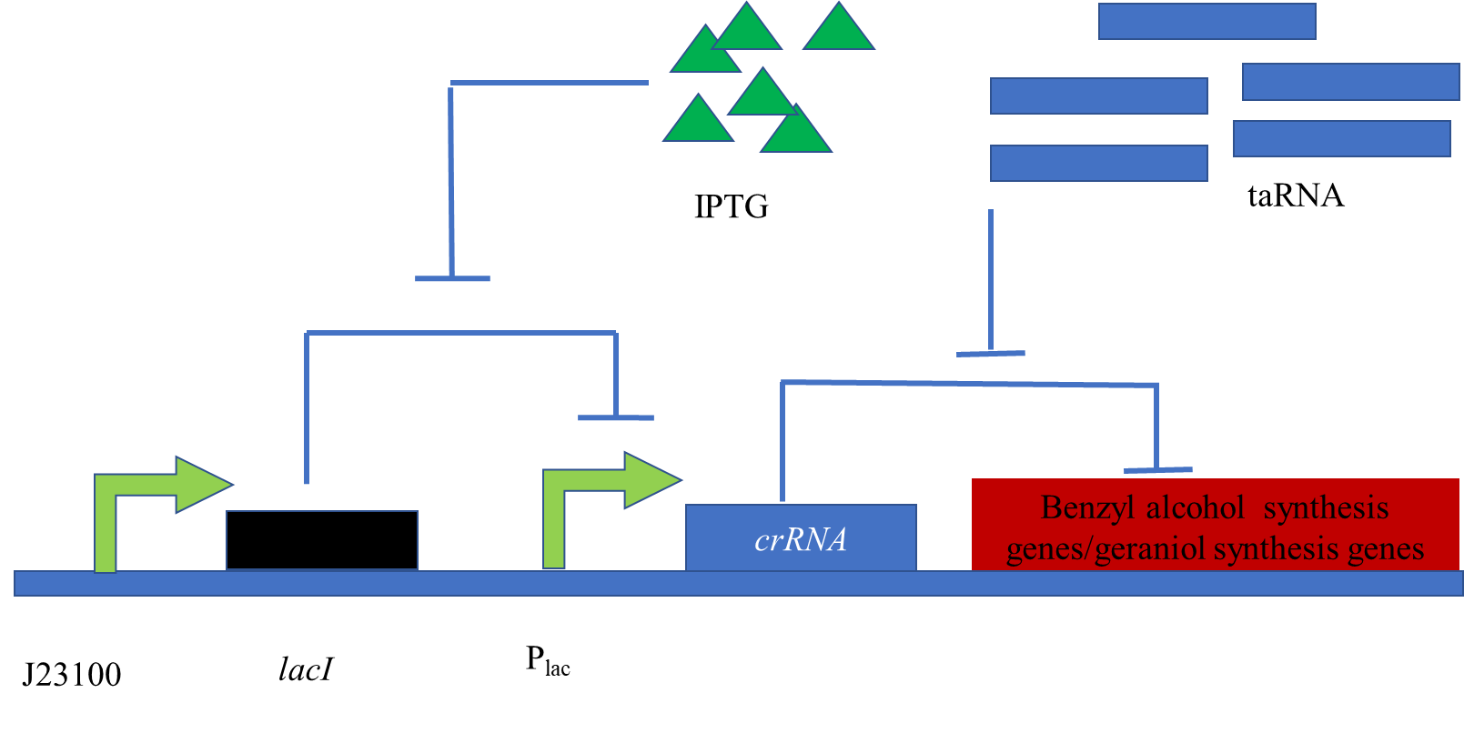
Odor release model：
crRNA induced by IPTG
crRNA unlocked by taRNA accumulated by memory system
IPTG
previous step
crRNA
taRNA
Benzyl alcohol/Geraniol

Slide 26
Memory erase system：
AiiO induced by ATC
AiiO hydrolyze AHL
ATC
ATc
AiiO
tetR
AHL
P_{tetA}
aiiO
P_{tetR}

Slide 27
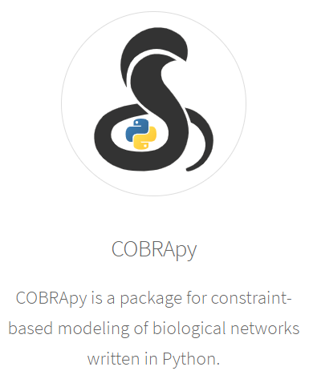

Metabolic model：
We used COBRApy and Escher to construct a genome wide metabolic model

Slide 28
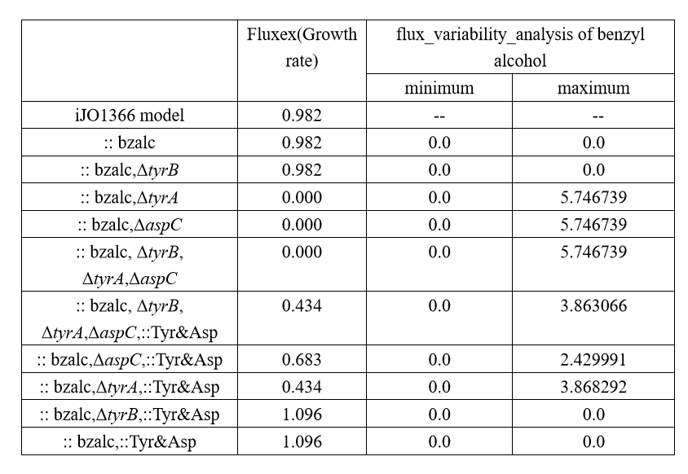

Slide 29
Hardware：
Mini & Quantitative & portable bacterial culture device
To achieve smell phonograph
This is still in the thought stage，so welcome to various advice

Slide 30
The all detailed formulas and codes have been uploaded
to GitHub https://github.com/hzau-igem-2019

Slide 31
Human Practice

Slide 32

Overview
In this year,
we divide our Human Practice activities into two parts:
1.the popularization of science
2.our project

Slide 33
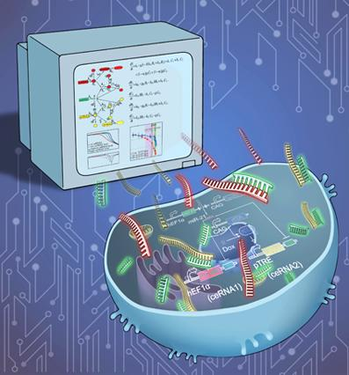
Popularization Of Science
Large-scale Activity
Vehicle

Slide 34
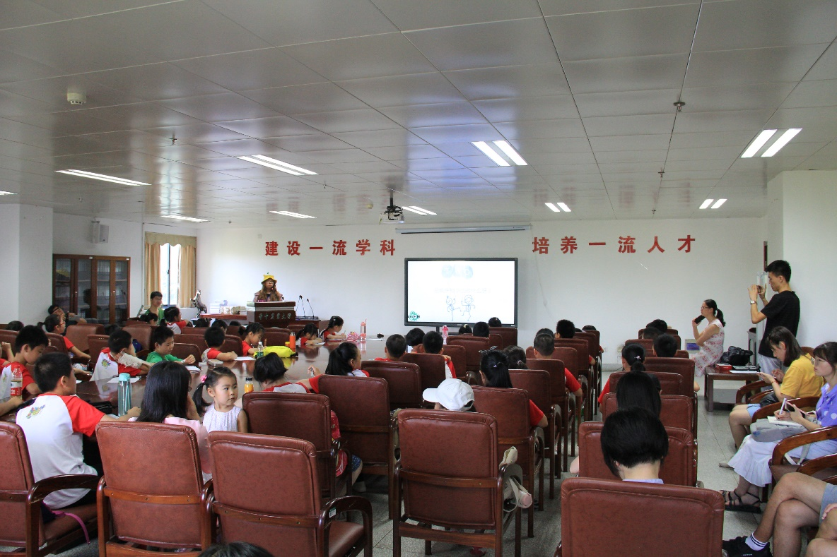
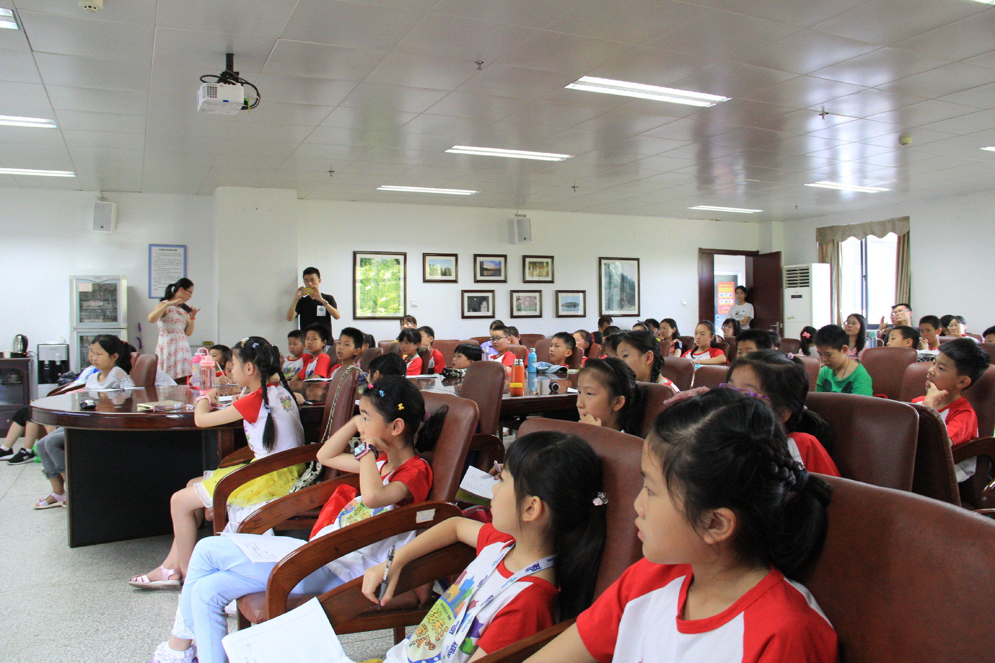
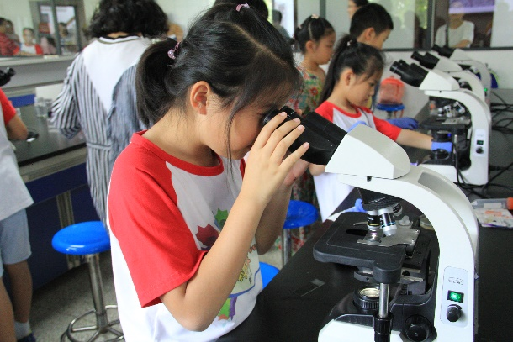
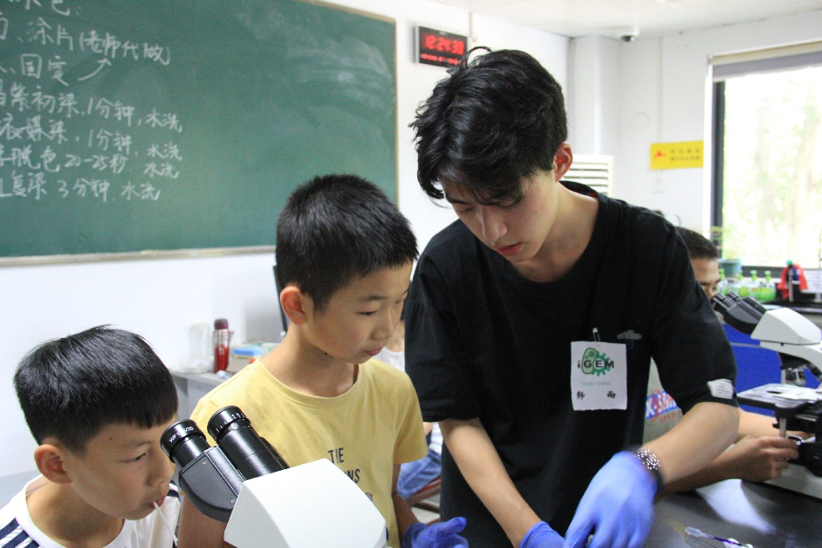
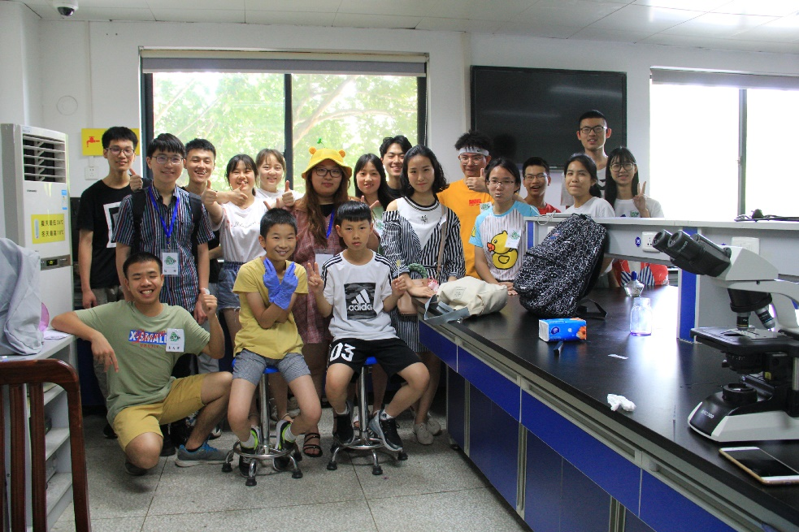
Future Scientists

Slide 35


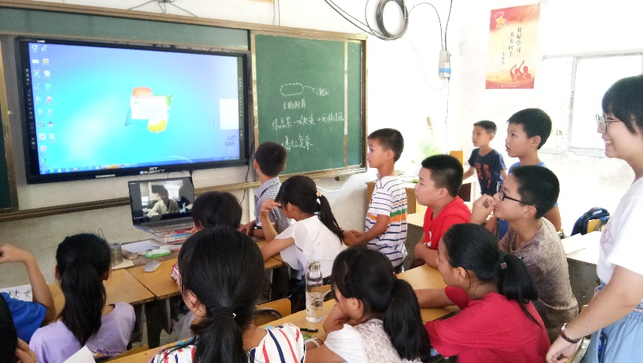
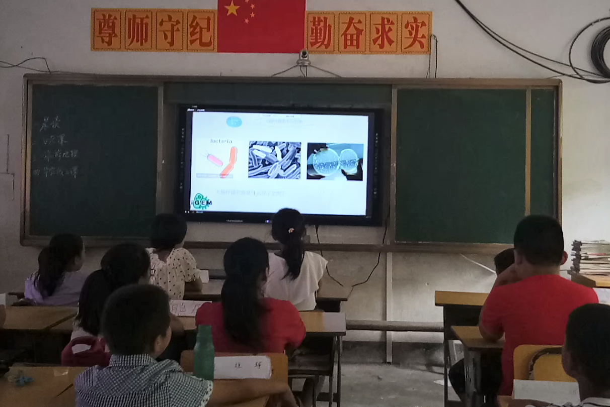
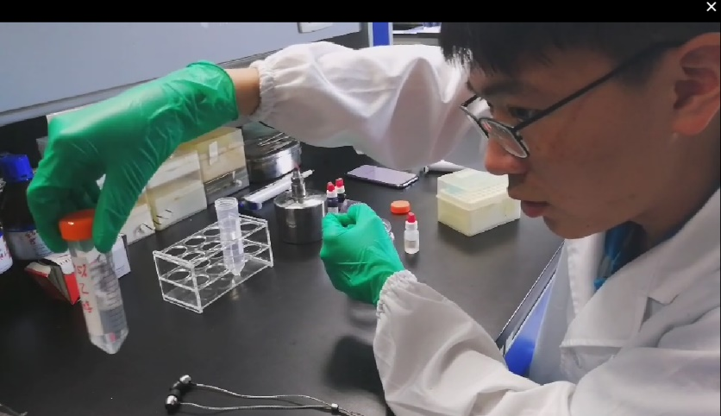
Online Courses

Slide 36
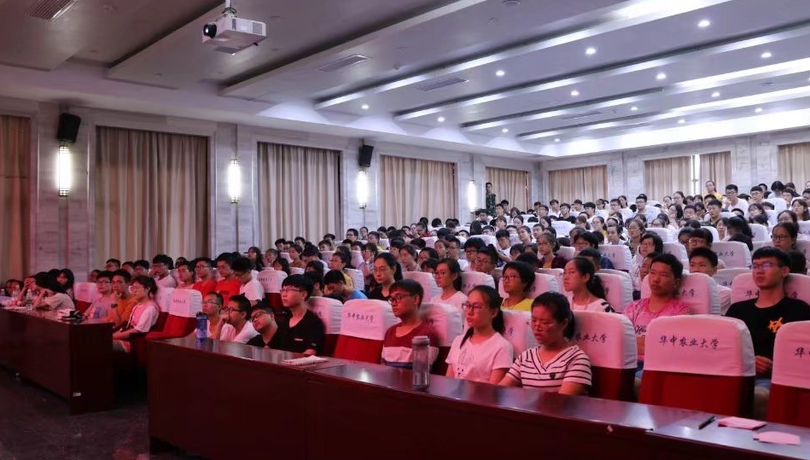
First-year Seminars

Slide 37


Vehicle: WeChat Official Account Qzune Twitter
Popularization Of Science

Slide 38
About Our Project
Questionnaire Survey
Thematic Activities
Experiment Record
Collaboration

Slide 39
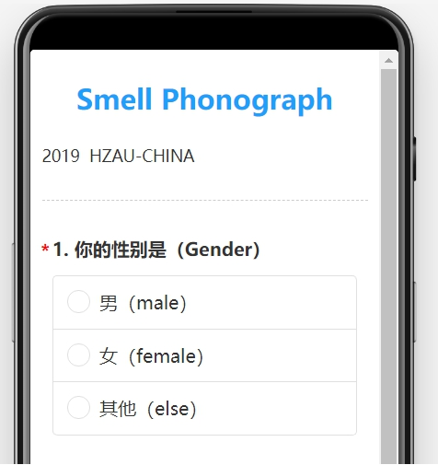
Questionnaire Survey

Slide 40

Thematic Activities
When We Grow Up
Your flavor , My mind

Slide 41
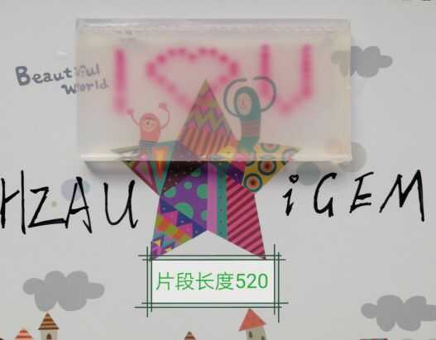
Experiment Record

Slide 42
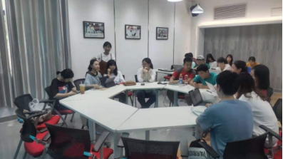
Collaboration

